Slide 1

Introduction to PDC
Centre for high performance computing
Arash Alizad Banaei

Slide 2
What is PDC?
A supercomputing centre founded in 1990
SNIC centre(SNIC > Swedish National Infrastructure for Computing)
Under administration of School of Electrical Engineering and Computer Science (EECS) at KTH
Providing high performance computing (HPC) services for academic and business/industrial research.
Services include HPC systems for performing computations and simulations (as well as pre- and post-processing of data), short- and long-term data storage, and assistance from application and systems experts

Slide 3

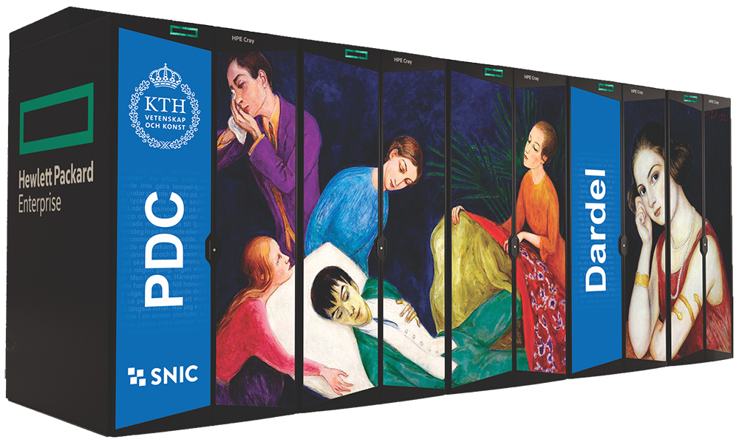
HPC Systems
Beskow:
Cray XC40 system
Intel Haswell and Broadwell processors
Designed for running large parallel jobs
Tegner
Pre and post processing system for Beskow
Intel CPUs + NVIDIA Tesla GPUs
Has large memory nodes: 0.5-1-2 TB
Dardel
New system of PDC arrived a few months ago!
Dual AMD EPYC™ 2.25 GHz 64 core processor
AMD Instinct™ MI200 GPUs
Will be used for OpenFOAM training

Slide 4
Dardel Compute nodes
Number of nodes | RAM (GB) | Name
488 | 256 | Thin
20 | 512 | Large
8 | 1024 | Huge
2 | 2048 | Giant
36 | 256 | Business
? | 256 | Scania

Slide 5
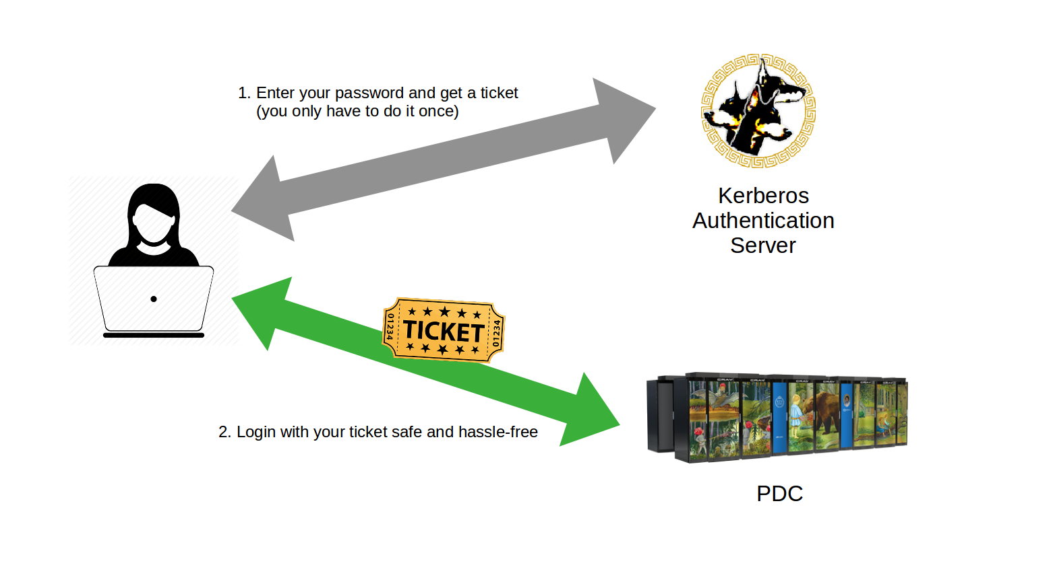
Getting started with Dardel How to login: two step login using Kerberos ticket
Kinit –f <username>@NADA.KTH.SE ssh –X <username>@nils.pdc.kth.se

Slide 6
Getting started with Dardel How to login
Apply for a PDC account!
https://pdc-web.eecs.kth.se/accounts/
Receive your password by SMS
Follow steps in: https://www.pdc.kth.se/support/documents/login/login.html#step-by-step-login-tutorial
Contact PDC support in case of login issues:
support@pdc.kth.se

Slide 7
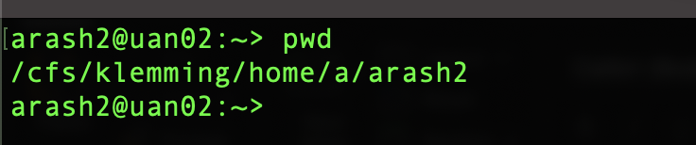
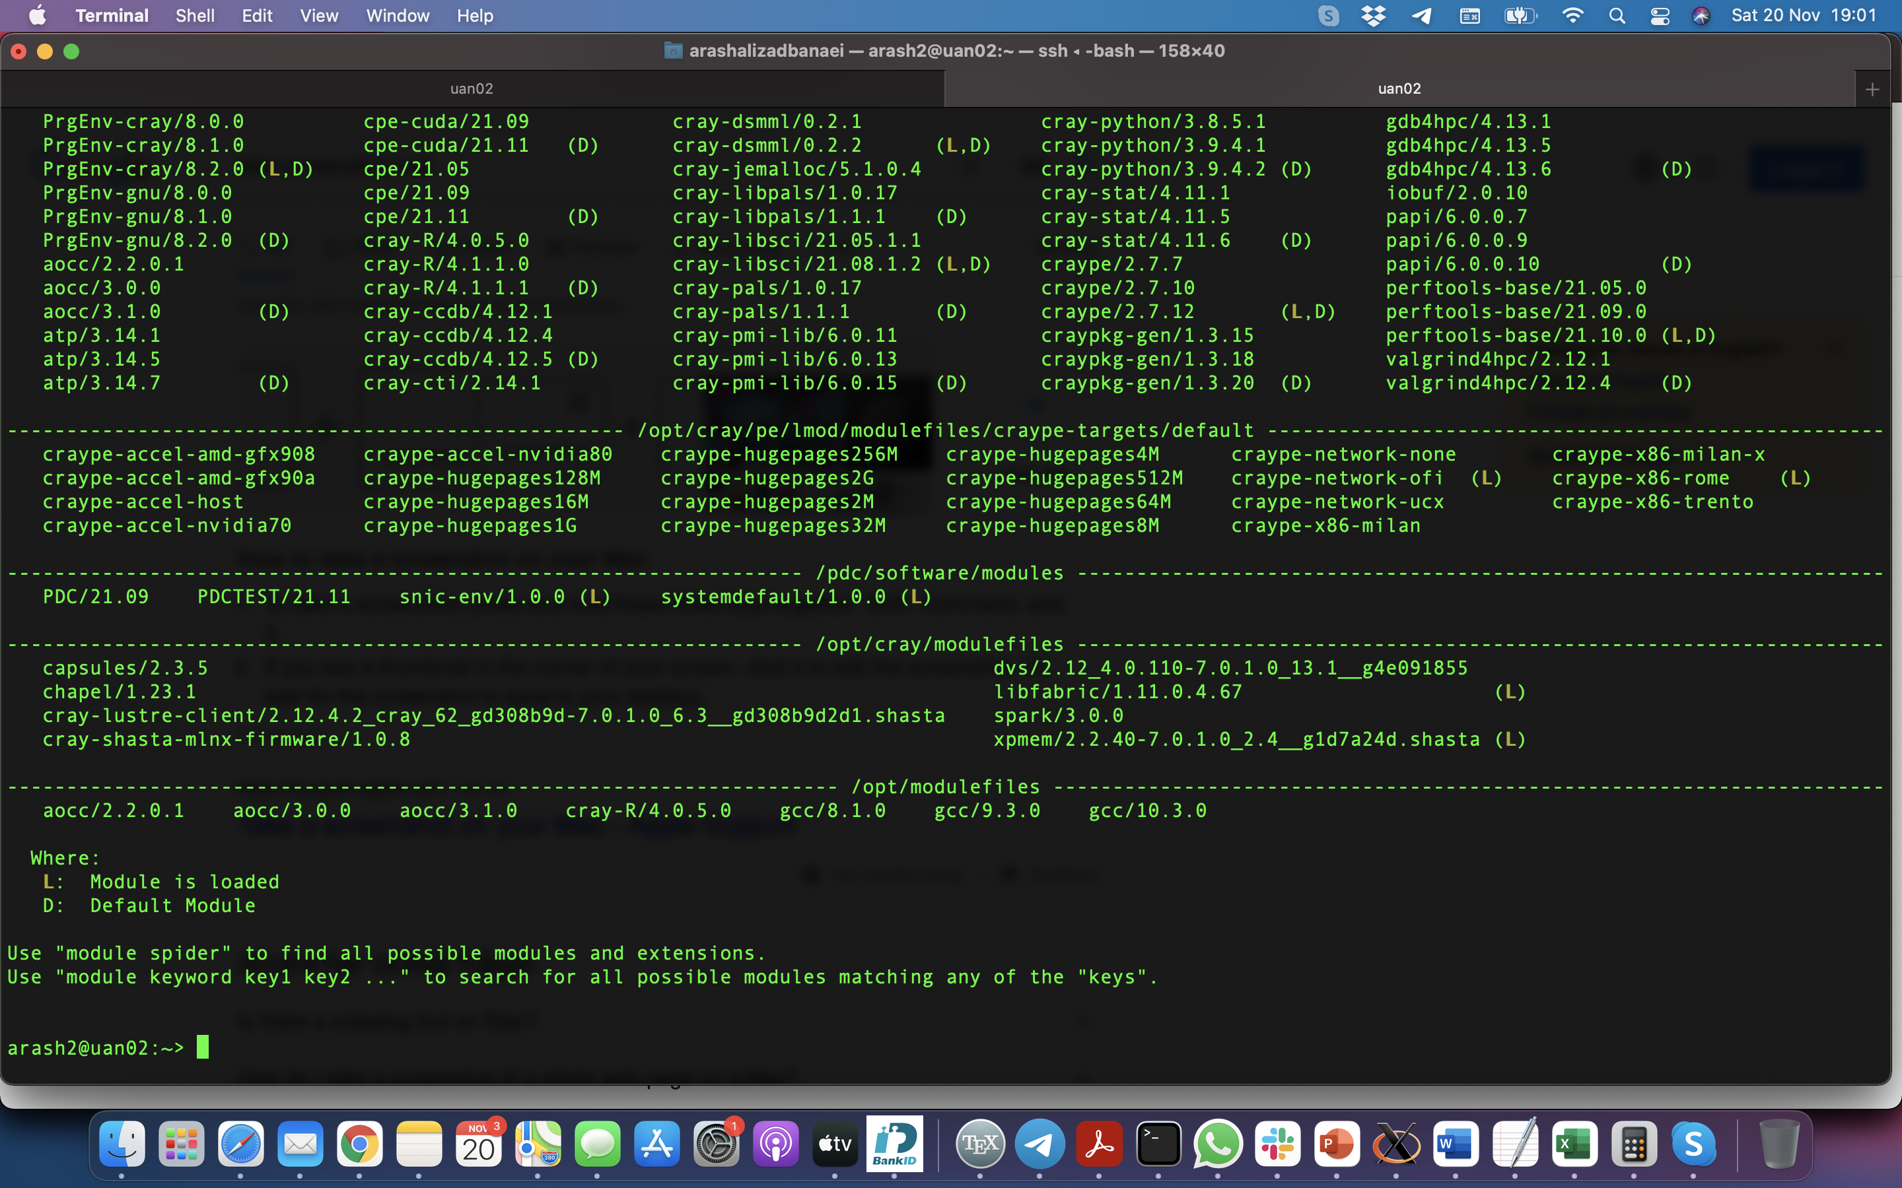
OpenFOAM on Dardel
Once logged in, you will be on your home directory:
/cfs/klemming/home/<letter>/<username>
All the operations will be performed on your home directory
Run ‘module avail’ to see available modules:

Slide 8
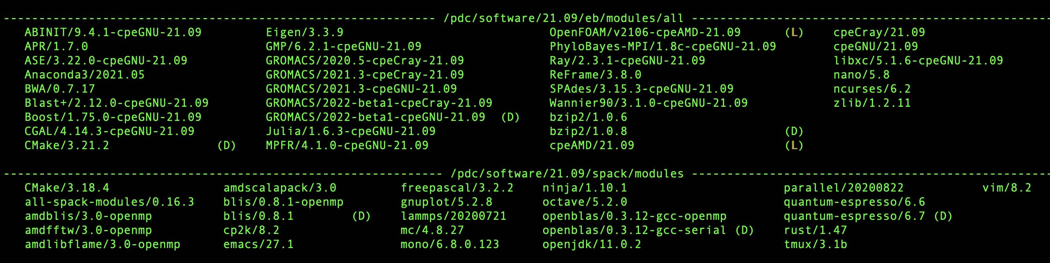
OpenFOAM on Dardel
Load ’ PDC/21.09 ‘ module to access to the software installed by PDC
module load PDC/21.09
Run ‘module list’ again. Now you should be able to see PDC modules

Slide 9
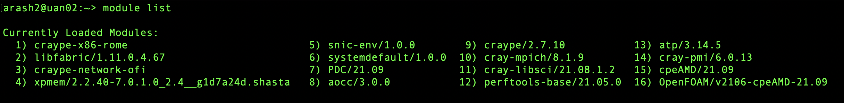
OpenFOAM on Dardel
Load ’ OpenFOAM‘ module:
module load OpenFOAM/v2106-cpeAMD-21.09
Run ‘module list’ to make sure the module is loaded
Now you have access to OpenFOAM on Dardel!

Slide 10
OpenFOAM on Dardel
Now you need to run a script to set some environment variables and paths for OpenFOAM:
. $FOAM_BASHRC
Copy OpenFOAM tutorials to your home directory:
cp -r $WM_PROJECT_DIR/tutorials .
Now You’re ready for the analysis! You have Necessary files on your home directory

Slide 11
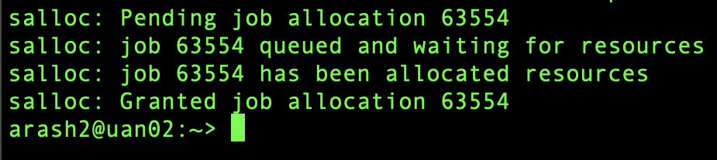
How to run OpenFOAM on Dardel
You are already on the ‘login node’ and do not have access to the compute resources. You need to request a compute node:
Request a compute node using ‘salloc’ command
salloc –N 1 -t 03:00:00 –A edu21.opfm
15 nodes are reserved for this course. Each compute node has 128 cores
You should see Something like this once you’re granted a compute node:
Number of nodes
Time
Account

Slide 12
How to run OpenFOAM on Dardel
To run your job you use srun command:
srun –n 32 icoFoam -parallel
Important note: You should always use ‘srun’ command to run your job otherwise it will run on the login node and makes troubles for the system.
Number of cores
OpenFOAM binary
OpenFOAM option

Slide 13
Good luck with the computations!

